Slide 1
Dino Diner

Slide 2

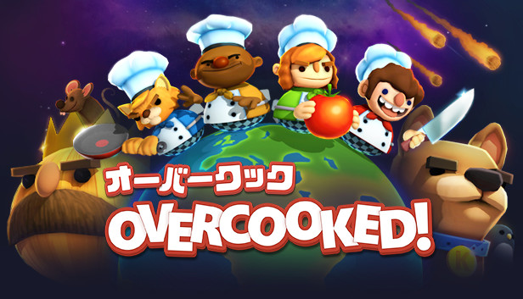
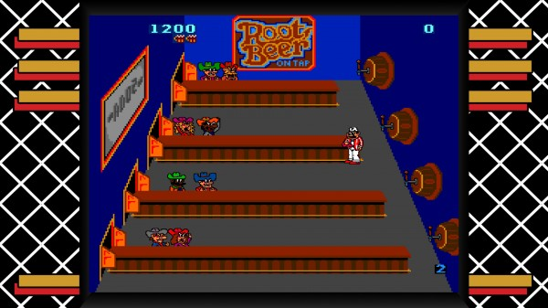
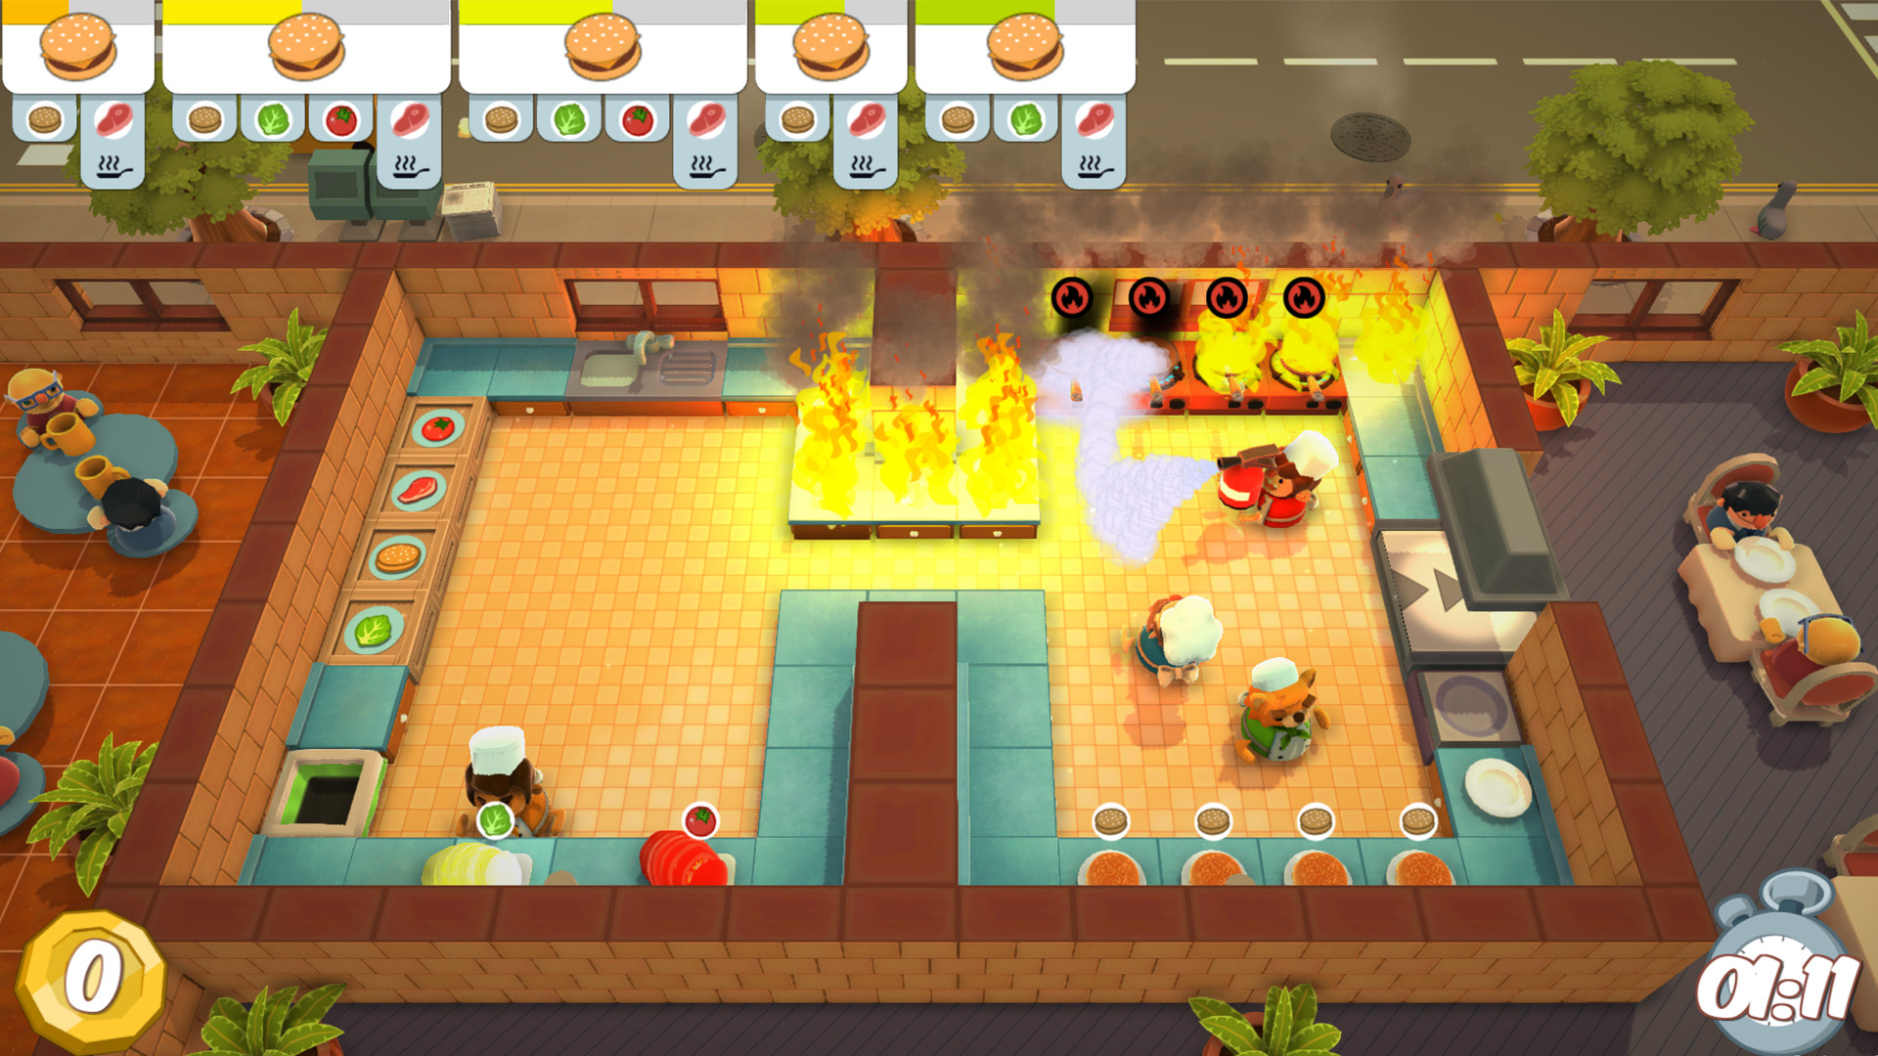
Concept

Slide 3
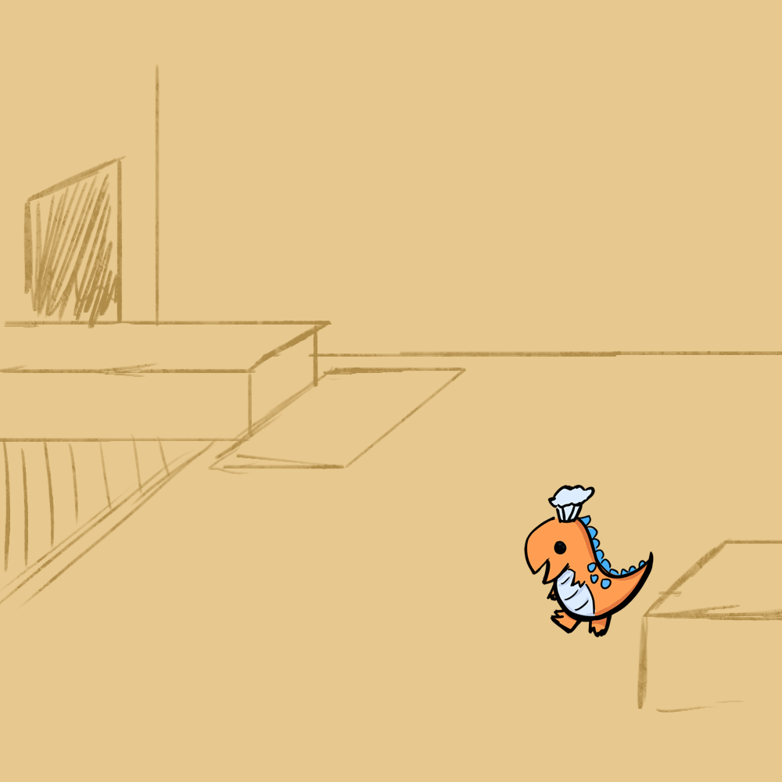
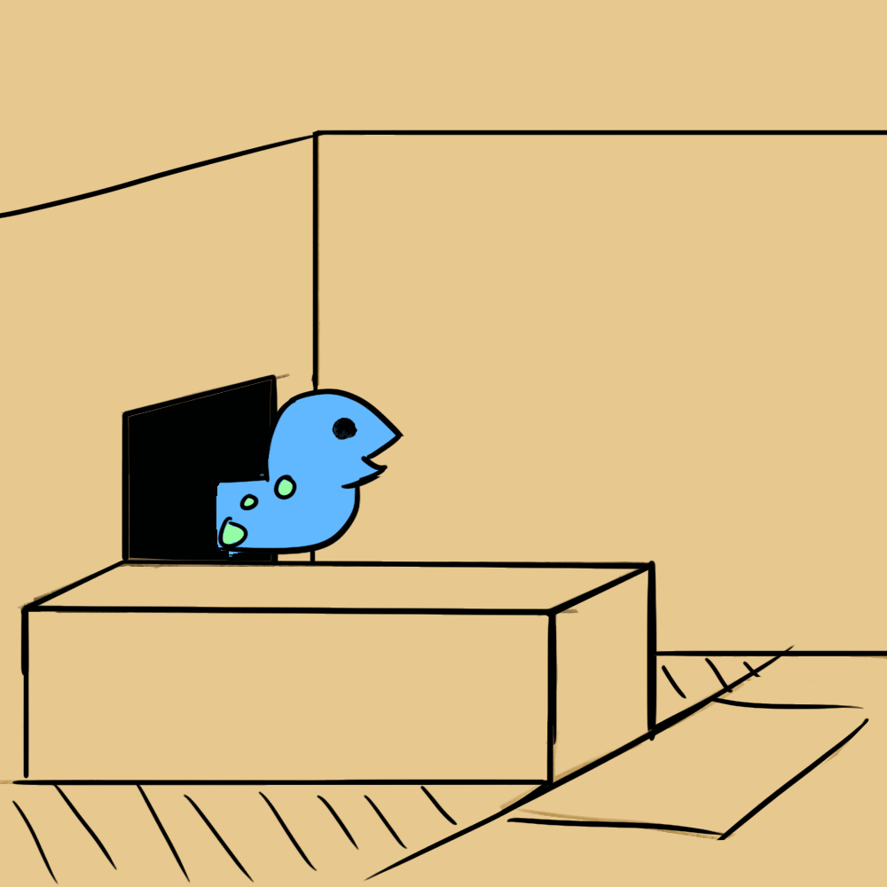
Art Style

Slide 4
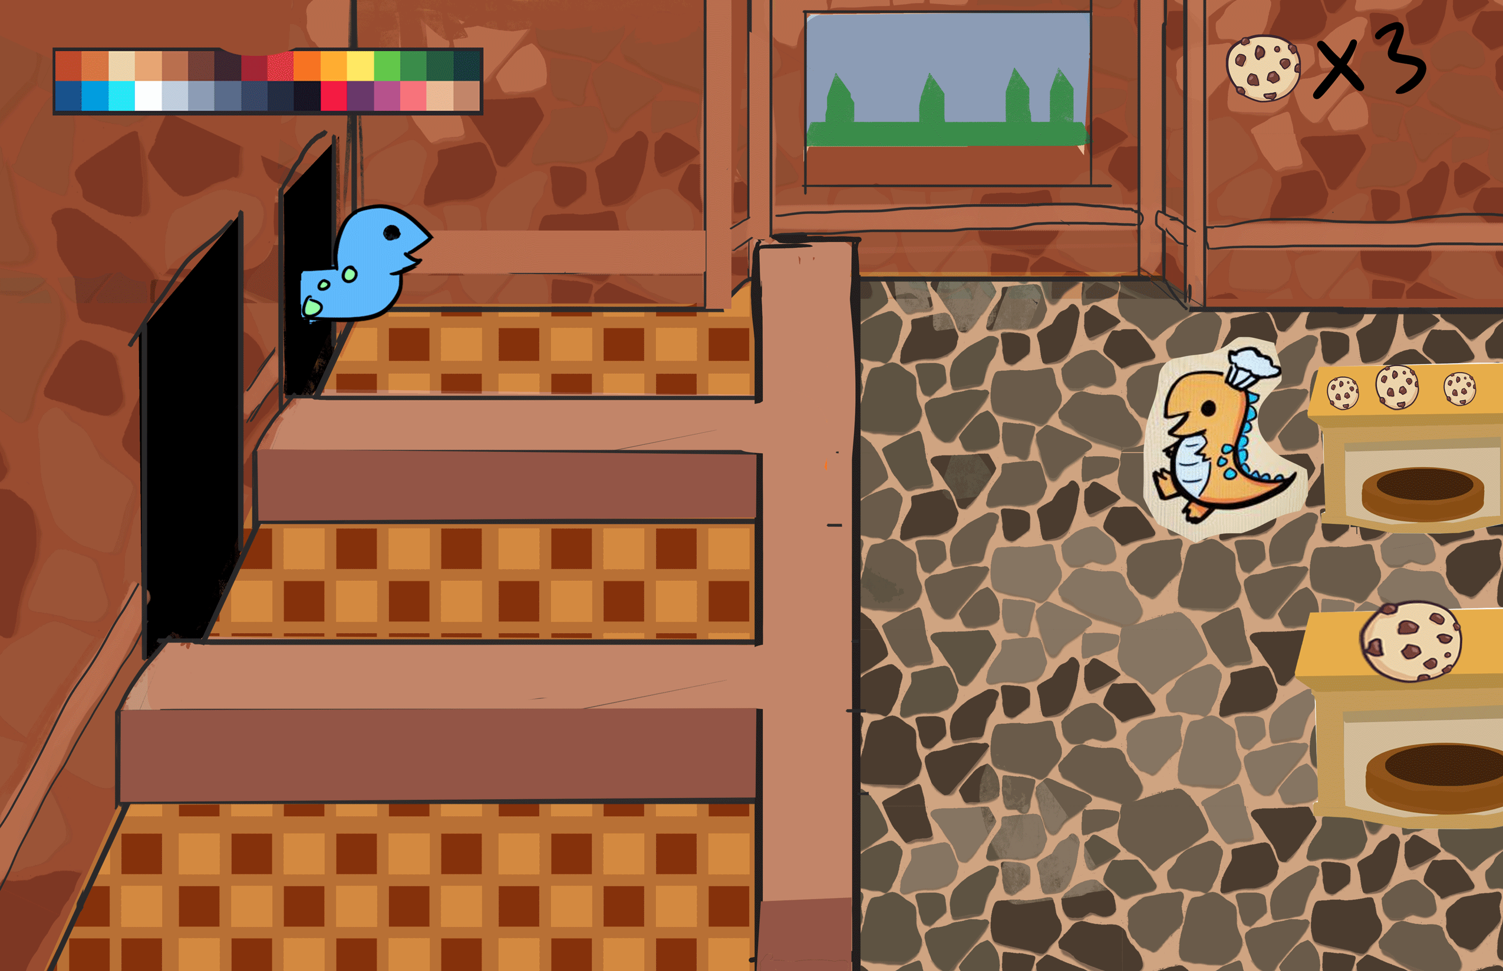
Gameplay
Can carry a limited number of cookies
Customers come in to receive cookies
Cookies will take time to bake
Player moves to serve customers

